Slide 1
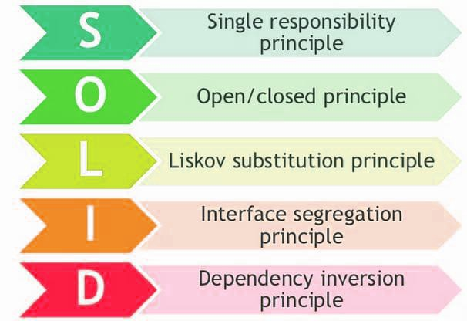
SOLID Principles
What is the Goal?
1.To reduce dependencies.
2.So that developers can change one area of software without impacting the other parts of the software.
3. Ensures that the software is decoupled, modular, easy to understand , maintainable and easy to test. Also achieves the parallel Development.

Slide 2
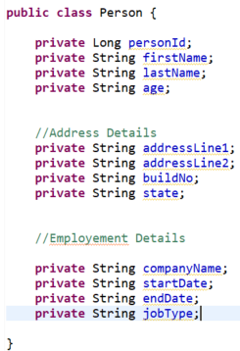
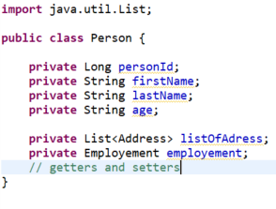
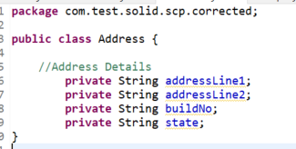
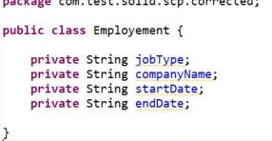
SRP (Single Responsibility Principle)
The class Person is holding 3 different types of properties. We have to change this class for 3 different reasons. One for basic info, one for address and one for Employment details.
Separated into 3 different classes. Now each class is independent and responsible for only one job.
If we want to change the state of Person, then we do not need to modify the state of other objects.

Slide 3
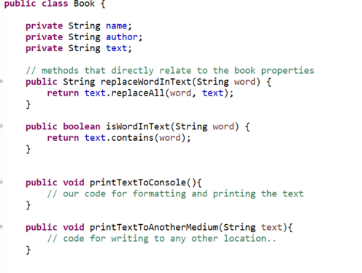
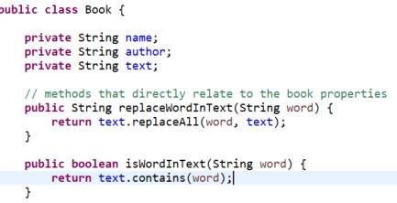
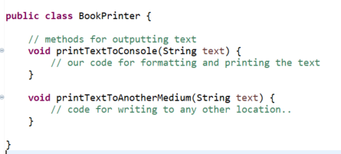
One more Example
The Book class has two responsibilities. One is ‘operations on the book properties’ and another one is ‘printing to multiple mediums’.
This violates the SCP. We can move the printxxxx() methods to another class and that class is responsible for ‘printing’ only.
Now Both classes are in compliance with SRP.

Slide 4
SRP
“A class should only have one responsibility. Furthermore, it should have only one reason to change.”
Single Responsibility:
Every class should be responsible for one functionality.
It doesn’t mean that your classes shouldn’t contain more methods. The class can do multiple tasks and have numerous methods (not too many!), but at the end of the day, all these should serve to one actor/stakeholder/use case/functionality etc.
Everything in the class should be related to that single purpose.
Example:
In the Book class, we have added two methods. These two methods perform the String operations like search/modify. In another class we have two methods related to the job ‘PRINTING’. So here one class is responsible for String manipulations. The other class is responsible for ‘Printing’.
Single Reason to Change your class:
Any change that you are going to perform should be related to the same purpose. It should know only about one thing. The change should be requested by one stakeholder/one actor. For Example: We have added two methods in the BookPrinter.java . The next change should be like adding another method which is related to the printing only. This change request be made by the actor from the PRINT Department. Any change in any methods should be related to that ‘Printing functionality’.

Slide 5
Exrecise:
An Utility class has methods on Arithmetic Operations and methods to calculate the Areas of quadrilaterals ( Square, Rectangles…). Is it following SRP? If not how can we change this?
An UserRegistration class contains the below 4 methods.
boolean login (String username, String Password){}
Boolean register (String username, String password, String eMail) {}
void logError(String error) {}
void sendEmail(String emailContent){}
Is it following the SRP? If not, how can we fix this?
3) There is a class which performs following operations.
1) Connected to a database
2) Read some data from database tables
3) Finally, write it to a file. How many responsibilities this class is handling? Is it following SRP? If no, how can we change this?

Slide 6
Summary -SRP
Every class ( or a group of classes/packages or a module) should be responsible for solving one problem.
The owner/actor of the module is the reason to change that class/module. Because that actor only should raise the new requirements/enhancements. Not the other actors from the other modules.
Loose coupling.
Easy to Test.
Not affected other classes/modules when a change is required.
Better code organization.
Many classes: But there is nothing wrong/right in having many classes. It all depends on the requirements.

Slide 7
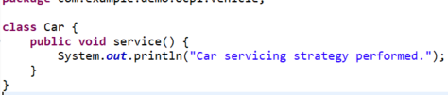

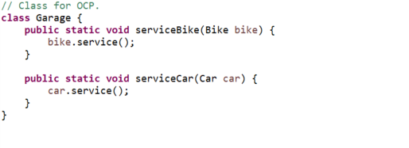
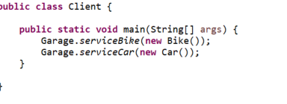
Open Close Principle (OCP) A Simple use case: 1. we have two classes (Car, Vehicle) that meets the SRP. The Class Garage also meets the SRP as we can change this class for a single reason ( that is to serve a new vehicle type like bus or truck). 2. Problem: But If we need to extends this feature for the other vehicles, How do we do?

Slide 8


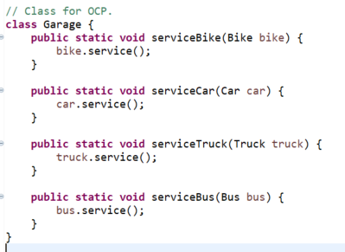
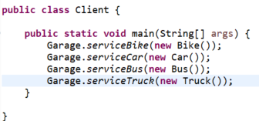
How do we extend this feature for other vehicles?
Notes:
Note: Don’t apply the Principles for the client classes. Client classes are just for demo.

Slide 9
Open Close Principle: software entities should be open for extension, but closed for modification
Open For Extension: This means that the behavior of the module can be extended.
We achieve the extension points as abstract methods.
Closed for modification: Extending the behavior of a module should not result in changes to the existing source code of the module.

Slide 10

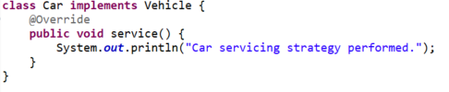
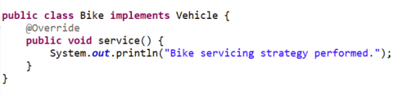
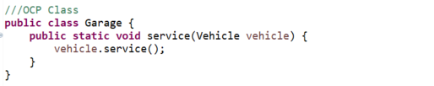
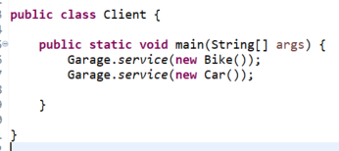
Solution. Now Vehicle and Garage are closed for modification but open for extension.

Slide 11


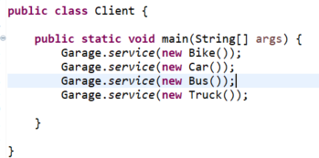
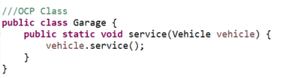
Open for extension

Slide 12
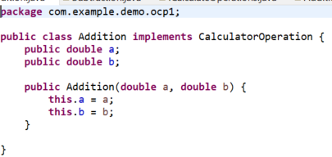
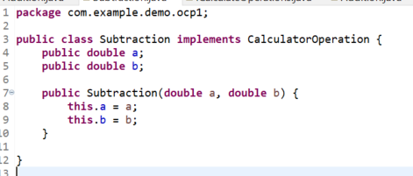
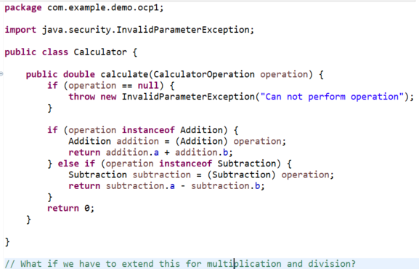

Exercise: Change the Design to meet OCP.
Notes:
Yes. We have two add two classes Multiplication and Division which are independent and no impact on the existing code. But To Extend this functionality( these two features) we have to modify the code .

Slide 13
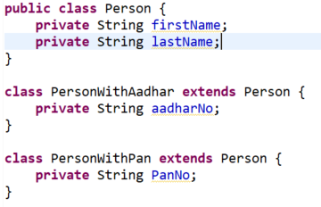
Summary
The functionality can be extended without making any changes to the existing source code.
If the design is in-compliance with OCP, then it is also in-compliance with SRP.
OCP can be achieved through abstraction layer only.
Extending a concrete class may not be a good example for OCP. Inheritance is “IS-A” relationship. It introduces tight-coupling if the subclasses depend on implementation details of the parent.
With inheritance the behavior of the parent methods can be changed by overriding. May need to write test cases for all the inherited methods too.
Due to the polymorphism, may have the data visibility issues. Person p = new PersonWithAadhar(); p don’t have access to aadharNo.
Any changes in the parent class will impact the child class. If you don’t want to change the parent class’s behavior (closed for modification), then need to override that behavior in all the childs.

Slide 14
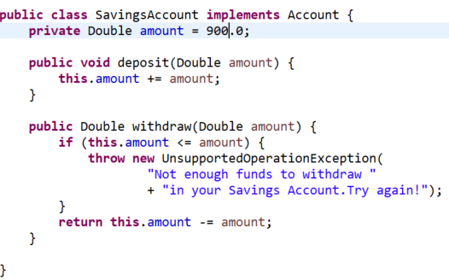
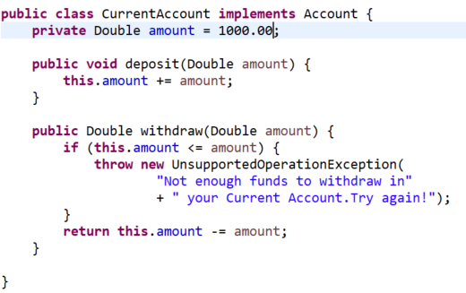
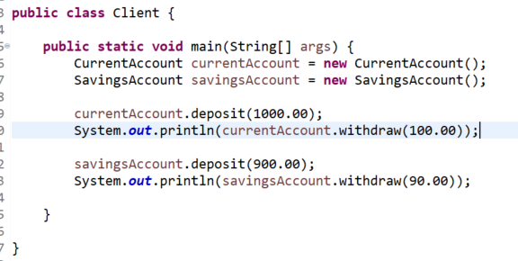
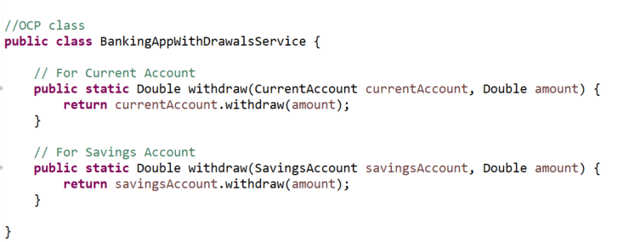
Prepare for LSP

Slide 15
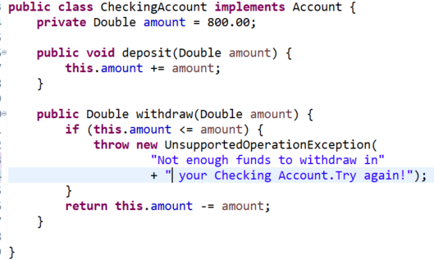
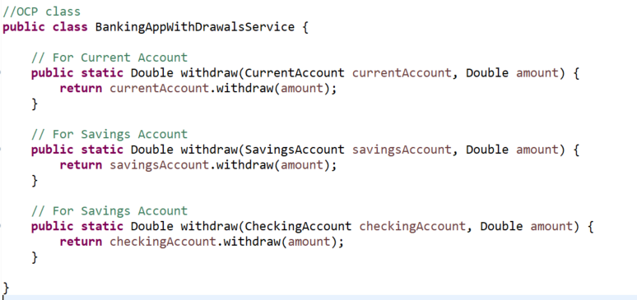
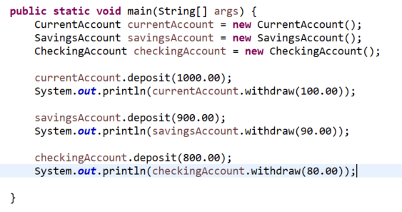
OCP-Voilation
Now a new account type called Checking needs to be added…… This meets the SRP. But violates the OCP.

Slide 16
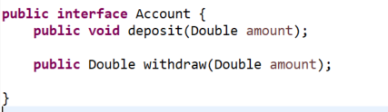
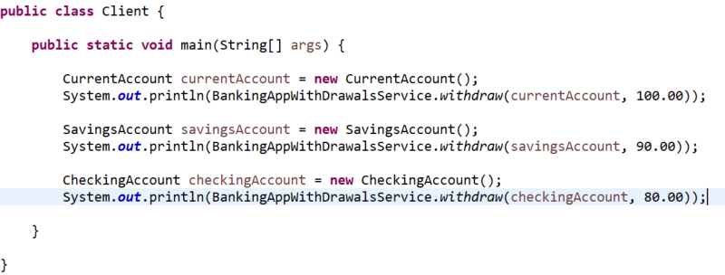
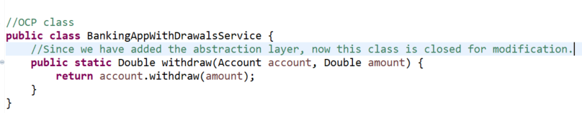
OCP says, don’t change the existing source code while adding new features. So the new design is

Slide 17
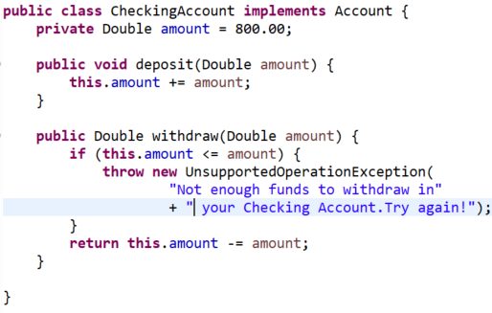
OCP-contd
Here we are extending the module to another account type. But none of the existing source files were modified. Don’t consider the changes in the client class.

Slide 18
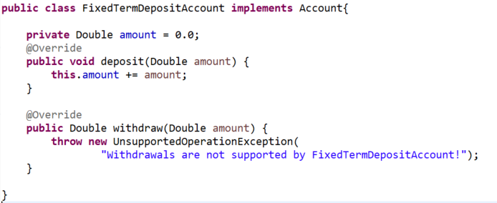
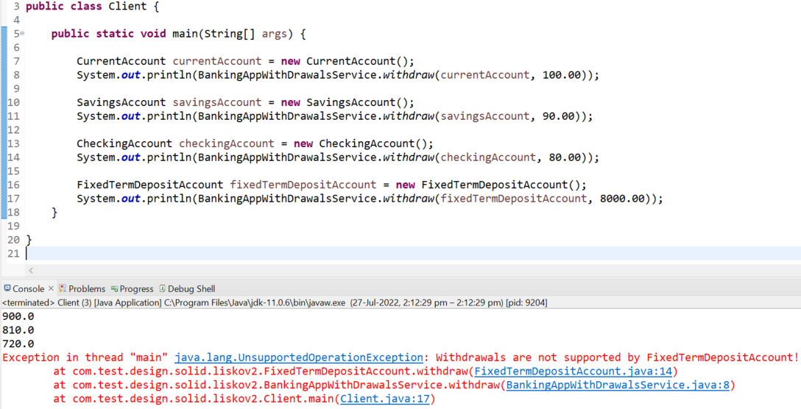
LSP-> Subtypes must be substitutable for their base types. To be substitutable, the subtype must behave like its supertype. Below example voilates this principle. The amount also should be declared as final for FDs.

Slide 19
Re-design to meet LSP
What went wrong?
LSP says “Subtypes must be substitutable for their base types”. if class A is a subtype of class B, we should be able to replace B with A without disrupting the behavior of our program.
The BankingAppWithdrawalService expects that both Account and its subtypes guarantee the same behavior that the Account (interface) class has specified for it’s withdraw method.
The new account type ‘FixedTermDepositAccount‘ violates this above rule (LSP).
So we cannot substitute the ‘FixedTermDepositAccount ‘ for Account.
What is the Solution?
Separate the deposit method from the Account interface. Create two more interfaces (WithdrableAccount and FixedTermAccount) with appropriate method. Follow the OCP.

Slide 20


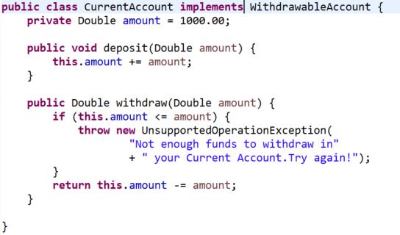
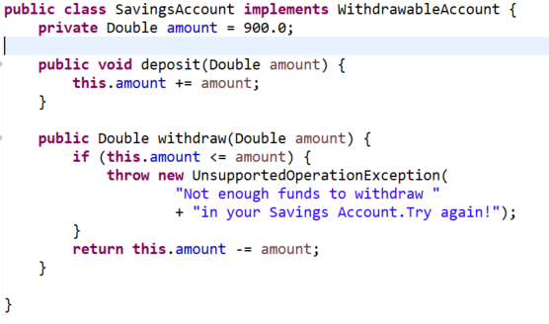
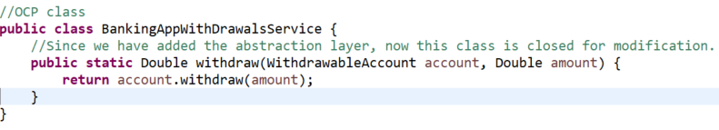
New Solution for withdraw

Slide 21
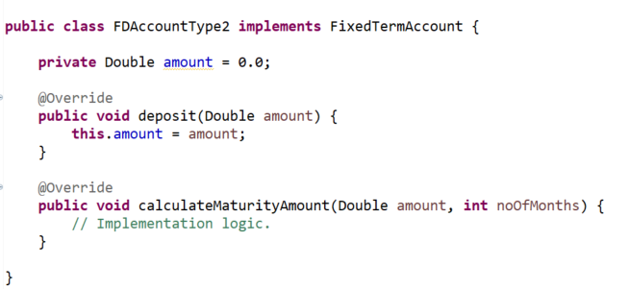
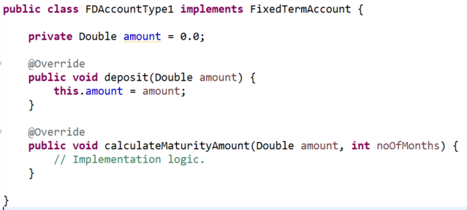
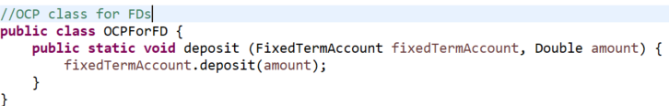
New Solution for Fixed Term Deposits

Slide 22
Interface Segragation
Larger interfaces should be split into smaller ones. By doing so, we can ensure that implementing classes only need to be concerned about the methods that are of interest to them.

Slide 23
Dependency Inversion
Decoupling.
The principle of dependency inversion refers to the decoupling of software modules. This way, instead of high-level modules depending on low-level modules, both will depend on abstractions.
Eclipse and its plugins with different versions.

